Slide 1

Secondary Education · Session 5
Working in Partnership
Notes:
SUGGESTED TIME: 1 min · 2:15 - 2:16
PURPOSE
Open the partnership session and connect it to the design work.
WHAT TO DO
1. Name the shift from what educators can redesign to how home and school can understand and act together.
2. Everything designed in Session 4 was based on what teachers can see and work out for themselves. This session is about hearing from the people who know the student best.
3. Pick up the "Who I will involve" line participants wrote on their Session 4 'My students' card.
4. Keep the student at the centre of the conversation.
5. Acknowledge that participants may bring both productive and difficult partnership experiences.
6. Remind the room that sharing is voluntary and examples stay anonymised (initials or roles only).
KEY MESSAGES
• Partnership is part of understanding and support, not an additional task after decisions are made.
• The student, family, support staff and school may each hold different parts of the picture.
KEEP IN MIND
• Energy is lower in the afternoon. This session relies on discussion and examples rather than a lot of new content.
THREAD
Picks up the "Who I will involve" line from the Session 4 'My students' card (Participant Guide p. 21).

Slide 2
Working in partnership
Family
School staff
What is the goal of these intersecting partnerships?
Every partner brings different knowledge and a different relationship with the student.
The student is at the centre of every partnership.
Student
Support staff
Notes:
SUGGESTED TIME: 3 min · 2:16 - 2:19 · Participant Guide p.22 - Session 5 summary
PURPOSE
Show where the partnerships around a student intersect, with the student at the centre of every one.
WHAT TO DO
1. Introduce the Venn: family, school staff and support staff, with the student at the centre.
2. Explain that every partner brings unique knowledge, expertise and perspectives, and a different relationship with the student and with each other.
3. Name the secondary picture: there are more people involved. Six or more subject teachers, a year level coordinator, learning support, support staff, and sometimes a relief teacher.
4. Ask the group: What is the goal of these intersecting partnerships?
5. Steer the discussion so the point is made that the student is at the centre of all partnerships.
6. Acknowledge support staff directly. They often see more of the student across the day than any one teacher, and their knowledge is not always asked for or credited.
7. Ask who is missing from the picture and how the student's own communication can be included.
8. Point participants to Where partnerships converge in the Participant Guide (p. 22).
YOU MIGHT SAY
What is the goal of these intersecting partnerships?
KEY MESSAGES
• Positive partnership keeps the student at the centre.
• No single person holds the complete picture. In secondary it is spread across more people.
• Every partner brings different knowledge and a different relationship with the student.
• The student knows things no assessment captures: what it feels like, what helps and what is hard.
• The family sees things over time that school may not: how the student is after school, how Sunday nights go, the strategy that worked in primary school.
KEEP IN MIND
• Use the elements as discussion prompts rather than a complete definition.
BACKGROUND
With session time limited, this slide is a chance to see where all the partnerships converge and what is needed for success across all of them. Observation only shows a teacher the outside of a student's experience. Asking the student and family fills in more of the picture, and their views are also part of the evidence for NCCD.
THREAD
Draws on sensory and thinking (Session 2), communication, capacity and masking across the secondary day (Session 3) and the Session 4 design and continuum of support.

Slide 3

Building a home-school partnership
Parents and families are the first and continuing educators of their children
Learning is lifelong and occurs in multiple settings
Partnerships, schools and school communities flourish when the diversity and strengths of families are valued and leveraged
Community engagement expands responsibility and resources
Partnerships grow from mutual trust, respect and responsibility
Partnerships need committed, collaborative and creative leadership
Family-School Partnerships Framework, Department of Education, 2020
Notes:
SUGGESTED TIME: 3 min · 2:19 - 2:22
PURPOSE
Make positive partnership concrete in educator practice using the Family-School Partnerships Framework principles.
WHAT TO DO
1. Walk through the six Framework principles briefly.
2. Position family knowledge and school knowledge as different, useful perspectives.
3. Name the secondary reality: families have fewer informal contacts (no school gate conversations, and many teachers), so contact often narrows to reports and problems. Ask: who is the family's main point of contact?
4. Name what makes partnership visible in practice: a shared purpose, respectful listening, student voice and communication, clear accessible information, and agreed next steps, responsibilities and follow-up.
KEY MESSAGES
• The student, family and school may each see different parts of experience. Partnership helps these perspectives inform understanding, design, action and review from the beginning.
• Listening, clarity and shared next steps can be observed in practice.
KEEP IN MIND
• Avoid implying that agreement is required before listening or respect are possible.
RESOURCES
Family-School Partnerships Framework - Department of Education, Australian Government - https://www.education.gov.au/supporting-family-school-community-partnerships-learning/family-school-partnerships/family-school-partnerships-framework

Slide 4
What is effective collaboration?
Shared goals
Seeing other perspectives
Shared values
Invite curiosity: How could we work together for better learning outcomes?
Mutual trust and respect
Centring student voice
Consult on decision-making
Assume good intent
Notes:
SUGGESTED TIME: 3 min · 2:22 - 2:25
PURPOSE
Name the collaboration principles that strong partnerships share, whoever is at the table.
WHAT TO DO
1. Introduce the importance of collaboration: for Autistic students in secondary there are multiple collaboration points across multiple partnerships, and across multiple teachers.
2. Explain that the key collaboration skills are the same across all groups, and are vital for strong partnerships.
3. Ask the group: What are some of the key principles for effective collaboration to occur?
4. Build the discussion to cover: shared goals, shared values, mutual trust and respect, consulting on decision-making, seeing other perspectives, inviting curiosity, centring student voice, assuming good intent.
5. Click to show the points on the slide once the room has contributed.
YOU MIGHT SAY
What are some of the key principles for effective collaboration to occur?
How could we work together for better learning outcomes?
KEY MESSAGES
• The collaboration skills needed are the same across every partnership around the student.
BACKGROUND
The team added this slide because it works well with all parties and helps people see each other's perspectives.

Slide 5

Power dynamics
Power can sit in:
Student
Socio-economic status
Historical / cultural experiences of education
Speaking English vs speaking a language other than English
Pedagogy / understanding of school systems and curriculum
Home
School
Perception of the importance / experience of school
Notes:
SUGGESTED TIME: 3 min · 2:25 - 2:28
PURPOSE
Help participants notice how agendas, language, authority and decision-making shape consultation.
WHAT TO DO
1. Introduce the seesaw: school, home and the student.
2. Ask participants to think of their last difficult family meeting. Who chose the room, the time and the agenda? Give people a moment to think before moving on.
3. Name where power can sit: socio-economic status, historical and cultural experiences of education, speaking English or another language, understanding of school systems and curriculum, and perceptions of the importance of school.
4. Ask the power questions below to examine practice, not to blame individual participants.
5. Invite educators to identify where school language, timing or process may create a barrier.
YOU MIGHT SAY
Who sets the agenda?
Whose knowledge is heard?
Who can make decisions?
Is the student included in a way that works for them?
What could the school change about the process?
KEY MESSAGES
• Power is present in meeting structures, language and decision pathways.
• In most school meetings the school chooses the place, the time, the agenda and the language, and the family is often outnumbered.
• By secondary, many families have been to a lot of these meetings. Some arrive worried or on guard because of earlier experiences, at this school or another one.
KEEP IN MIND
• Avoid describing a family as difficult, disengaged or unrealistic without examining the context and process.
• Some participants will have had genuinely difficult or hostile meetings with families. Acknowledge that partnership works both ways, then come back to what the school can change.

Slide 6
Power dynamics activity
On Post-it notes:
1
Write an example of an imbalance in power dynamics from a home perspective.
2
Write an example of an imbalance in power dynamics from a school perspective.
3
Write how you could address these imbalances.
Share at your table, or add your notes to the wall under Home, School and Solutions.
6 minutes
Notes:
SUGGESTED TIME: 6 min · 2:28 - 2:34 · Participant Guide p.23 - Power dynamics
PURPOSE
Prompt educators to reflect honestly on perceived and real power imbalances in the home-school relationship.
WHAT TO DO
1. Make sure every participant has Post-it notes and a pen.
2. Direct participants to the three instructions on the slide.
3. Choose a sharing option that suits the room (see steps).
4. Support tables to look for solutions rather than place blame.
5. Take feedback from a few participants at the end.
KEY MESSAGES
• Power can be structural, historical, cultural, conscious and unconscious.
• Status can be perceived as an imbalanced power dynamic, regardless of intent.
ACTIVITY: Post-it note reflection · table groups · 6 minutes
Prompt: Where do power imbalances sit in the home-school relationship, and how could you address them?
1. On one Post-it, write an example of an imbalance in power dynamics from a home perspective.
2. On a second, write an example from a school perspective.
3. On a third, write how you could address these imbalances.
4. Option 1: share Post-it notes with your table.
5. Option 2 (movement break): take your Post-it notes to another person in the room to share.
6. Option 3: place Post-it notes on butcher's paper on the wall under Home, School and Solutions.
Bring the room back:
• Who sets the agenda?
• Whose knowledge is heard?
• Who can make decisions?
• What could the school change about the process?
Close: Ask participants to keep one process change for their family-conversation plan.
KEEP IN MIND
• This may be challenging for some participants, who may have found themselves in positions of power or lack of power at different times in their career. Guide individuals to seek solutions and not place blame.
BACKGROUND
Educators are immersed in the culture of education, including a shared understanding of acronyms (e.g. NAPLAN, NCCD, IEP) and secondary systems (subject selection, pathways, senior certificate requirements) which families may not be able to access as easily. Some people will purposely and naturally endow teachers with higher status, which can be a cultural or personal attitude. External providers and professionals can also affect the power dynamic between those working with and supporting Autistic students. In secondary, the student sits in the power picture too: adolescents are often discussed in meetings they were not invited to.
THREAD
The process change chosen here carries into the bridge reflection (slide 18) and the Session 6 conversation plan.

Slide 7

Student voice
What decisions were made, and who made them?
What impact did those decisions have on Adon?
Notes:
SUGGESTED TIME: 5 min · 2:34 - 2:39 · Participant Guide p.23 - Student voice
PURPOSE
Show what happens when a student is not listened to or consulted.
WHAT TO DO
1. Introduce the video as an example of a student who is neither listened to nor consulted.
2. Ask participants, while watching, to pay attention to what decisions were made and who made them.
3. Play the video.
4. Ask the group: What impact did those decisions have on Adon?
5. Connect to the students participants have in mind: how are their preferences asked and heard, and by which of their teachers?
YOU MIGHT SAY
While watching, pay attention to what decisions were made and who made them.
What impact did those decisions have on Adon?
KEY MESSAGES
• Students should have a say in decisions about them, at their level and in a way that works for them.
• Ask students the questions their way: what helps? what's hard? what should teachers know?
• Record their answers in their own words.
• For adolescents, being asked is the starting point. Taking part in their meetings, and over time leading them, comes next (slide 13).

Slide 8
Partnership activity
For each partner: what do they bring, and what challenges might they face?
Student
Parents and carers
Subject teachers
Year level and support staff
Brings
Brings
Brings
Brings
Challenges
Challenges
Challenges
Challenges
8 minutes
Then compare: what do all four have in common?
Notes:
SUGGESTED TIME: 8 min · 2:39 - 2:47 · Participant Guide p.24 - Partnership activity
PURPOSE
Compare what each partner brings and the challenges they may face, and find what they share.
WHAT TO DO
1. Make sure each table has the Partnership activity grid in the Participant Guide (p. 24).
2. Ask table groups to record what each partner brings and what challenges they might face: the student, parents and carers, subject teachers, and year level and support staff.
3. For subject teachers, prompt the secondary picture: each one sees the student for a few periods a week, in one subject.
4. For year level and support staff, prompt what year level coordinators, learning support staff, and learning support officers or teacher aides see across the day and the year that a single subject teacher may not.
5. Ask tables to compare: what do all four have in common?
6. Take thoughts on similarities and differences, list the commonalities, and ask what would make the partnership more successful.
KEY MESSAGES
• Understanding the challenges and strengths of each partner can help build trust and confidence in the relationship.
• There are similarities and differences between what each partner brings to the partnership.
• Everyone has the student at the centre and student voice is included.
• At the heart of all interactions there should be an assumption of good intent regarding the outcomes for the student.
ACTIVITY: Table group partnership grid · table groups · 8 minutes
Prompt: For each partner: what do they bring, and what challenges might they face?
1. Work through the four partners: student, parents and carers, subject teachers, and year level and support staff.
2. For each, note what they bring and what challenges they might face.
3. Compare: what do all four have in common?
Bring the room back:
• What are the similarities and differences across the four partners?
• What would make the partnership more successful?
Close: List the commonalities the room names and link them to the collaboration principles on slide 4.

Slide 9

The first two minutes
Pairs: one of you is the teacher, the other plays a parent or a student.
Use a scenario from your Participant Guide. For two minutes, only ask and listen back. No solving yet. Then swap.
What helps:
Be prepared for meetings
Share information
Ask questions
Seek clarification
Assume the best
6 minutes
Notes:
SUGGESTED TIME: 6 min · 2:47 - 2:53 · Participant Guide p.24 - The first two minutes
PURPOSE
Practise opening a conversation with a parent or student by asking and listening before offering solutions.
WHAT TO DO
1. Put people into pairs and direct them to the three scenarios on p. 24 of the Participant Guide.
2. Explain the task: one person is the teacher, the other plays the parent or student in a scenario they choose. For two minutes the teacher only asks questions and says back what they have heard. No suggestions or solutions yet.
3. Keep it low-stakes. Nobody performs for the room and it does not need to be good acting. Anyone who would rather not role-play can write what they would ask and say in the first two minutes instead, then compare with their partner.
4. Call time at two minutes. Give people a moment to jot notes, then swap roles and use a different scenario.
5. Point to the What helps list on the slide as a reminder of what the teacher is aiming for.
6. Bring the room back with: What did asking first bring out? Take 2-3 responses. Then ask: What made it hard not to jump to solutions? You do not need to comment on each answer.
7. Close by asking everyone to write one question they will use to open a real conversation (the third box on p. 24). It can go straight into their bridge notes at the end of this session.
YOU MIGHT SAY
For two minutes, only ask and listen back. No solving yet.
What did asking first bring out?
What made it hard not to jump to solutions?
KEY MESSAGES
• Asking first gives the parent or student room to say what matters to them before the school decides what the problem is.
• Listening back, saying what you heard in your own words, shows you have understood and lets the other person correct you.
• Wanting to fix things quickly is normal for teachers. Holding off for two minutes often brings out information you would otherwise miss.
• What helps: be prepared for meetings, share information, ask questions, seek clarification, assume the best.
ACTIVITY: Paired practice · pairs · 6 minutes
Prompt: For two minutes, only ask and listen back. No solving yet. Then swap.
1. Choose a scenario from p. 24. One person is the teacher, the other plays the parent or student.
2. Scenario 1: a parent says their son in Year 8 has come home upset every afternoon this week. He won't say why, but he mentioned Science.
3. Scenario 2: a parent says their daughter has stopped handing in homework. She says she doesn't know what the teachers want.
4. Scenario 3: a Year 10 student has been asked to a meeting about adjustments for assessments, and isn't sure they want anyone to know.
5. For two minutes, the teacher only asks and listens back. No solving yet.
6. Swap roles and use a different scenario.
7. If you would rather not role-play, write what you would ask and say in the first two minutes, then compare with your partner.
8. Note your answers in the three boxes on p. 24: What did asking first bring out? What made it hard not to jump to solutions? A question I will use to open.
Bring the room back:
• What did asking first bring out?
• What made it hard not to jump to solutions?
Close: Ask everyone to write one question they will use to open a real conversation.
KEEP IN MIND
• Some participants find role-play uncomfortable. Offer the writing option at the start so it is a real choice, and keep the pairs working privately.
• Scenario 3 is about a student who may not want others to know about their needs or adjustments. If it comes up in the debrief, acknowledge that who knows is the student's choice, and that this is part of what the teacher is listening for.
• Keep to the scenarios. If people start talking about real students, remind them to use initials or roles only.
BACKGROUND
Teachers are often expected to come to a meeting with answers, so asking and listening first takes practice. The scenarios are deliberately incomplete: the teacher does not yet know what is going on, which is why they need to ask. Other things that help with families: send the agenda beforehand, welcome a support person, open with a strength, share notes or minutes, and follow up in writing ('as we agreed...'). Try to make sure the first contact about a student each term is not about a problem. If a meeting has gone badly, name it, offer a fresh start and make the next meeting fairer. Family engagement in learning works best when schools support families, as the experts in their young person, to take part in equal partnership with the school (Barker & Harris, 2020).
THREAD
The opening question written here feeds the Session 5 bridge (slide 18: What question will open the conversation?) and the opening sentence in the Session 6 conversation plan (p. 28).
RESOURCES
Barker, B., & Harris, D. (2020). Parent and Family Engagement: An Implementation Guide for School Communities. Canberra: ARACY
Tett, L. & Macleod, G. (2020) Enacting home-school partnerships: the roles of headteachers, family-learning practitioners and parents, Cambridge Journal of Education, 50:4, 451-468 https://doi.org/10.1080/0305764X.2020.1722062

Slide 10
Meeting families where they are
Listen before solving.
Ask about communication preferences and priorities
Make room for questions and uncertainty
Explain roles, options and next steps plainly
Check what is workable for the family now
Avoid judging a family's pace, response or choices
Environment-first thinking applies to meetings too: what could the school change about the process?
Notes:
SUGGESTED TIME: 2 min · 2:53 - 2:55
PURPOSE
Emphasise listening before solving, and making room for questions, uncertainty and different priorities.
WHAT TO DO
1. Read the six practices briefly.
2. Emphasise listening before solving, as in the first two minutes, and making room for questions, uncertainty and different priorities.
3. Remind the room of masking from Session 3: families often see what school does not, such as a student falling apart at home after holding it together all day, or dreading Sunday night before the school week. This is one of the main reasons partnership matters.
4. Ask in the way that suits the person: written questions sent in advance, a phone call instead of a meeting, a walk instead of sitting at a table, an interpreter booked before it is needed.
5. Invite educators to identify where school language, timing or process may create a barrier.
6. Finish with the line at the bottom of the slide: environment-first thinking applies to meetings too.
YOU MIGHT SAY
What could the school change about the process?
KEY MESSAGES
• Power is present in meeting structures, language and decision pathways.
• Meeting families where they are begins with listening and clarity.
• Environment-first thinking also applies to consultation processes.
KEEP IN MIND
• Avoid judging a family's pace, response or choices.
• Avoid describing a family as difficult, disengaged or unrealistic without examining the context and process.

Slide 11
Consultation literacy
Useful consultation includes:
A clear, shared purpose
Open questions
More than one way to contribute
Respect for student and family knowledge
Accurate recording of what was heard
An agreed action, responsibility and follow-up
Ask, listen, and follow up.
Notes:
SUGGESTED TIME: 2 min · 2:55 - 2:57 · Participant Guide p.25 - Consultation checklist
PURPOSE
Introduce consultation literacy through asking well, listening and following up.
WHAT TO DO
1. Walk through what useful consultation includes.
2. Compare two questions: 'Any concerns?' and 'What does a good morning look like?' Ask what each one would bring out.
3. Point out that following up is easy to skip: tell the family and student what you did with what they told you. It makes them more likely to tell you things next time.
4. Frame the list as a check participants can use before and after a meeting.
5. Finish with the line on the slide: ask, listen, and follow up.
KEY MESSAGES
• Ask, listen, and follow up.
• Ask specific questions, and ask in the way that suits the person.
• Views that are recorded and acted on are good practice, and they are also evidence.
• Tools should support consultation rather than replace listening and student voice.

Slide 12
Consulting students and families
With students
With families
Offer communication choices
Meeting preparation
Start with students’ strengths and interests
Listen to families and value their insights
Simple choices
Processing time
Use clear, simple language
Respect different perspectives / experiences
Sensory-friendly spaces
Behaviour as communication
Focus on needs, goals and participation
Use real examples from school
Strengths and interests
Support - don’t speak for
Check for shared understanding
Agree on next steps
Clear, accessible questions
Keep communication open and ongoing
Notes:
SUGGESTED TIME: 2 min · 2:57 - 2:59
PURPOSE
Give practical ways to consult students and families so every voice can be heard.
WHAT TO DO
1. Take the two columns in turn: with students, then with families.
2. With students: presume competence, provide communication supports, offer choices, allow time, and act on what students tell us. Adolescents can prepare their own contribution: a written list, a one-page profile, or a trusted adult who supports them to speak rather than speaking for them.
3. With families: start with the student's strengths, interests and what works well, and listen to families' knowledge of their young person without making assumptions.
4. Ask participants to pick one practice from each column to try with the students they have in mind.
KEY MESSAGES
• Listen, adapt, give choices, and make it easy for every student to have a voice.
• Ensure trusted supporters assist communication without replacing the student's voice.
• Use plain language and explain educational terms clearly.
• Focus on the student's needs and goals, not just their diagnosis.
• Recognise that some parents will be neurodivergent themselves.
BACKGROUND
Student consultation: provide multiple communication options (AAC, visuals, writing, drawing, video, symbols); prepare students in advance with questions, agendas and meeting information; use supported decision-making with simple choices and extra processing time; create sensory-friendly environments; recognise that behaviour is communication and can indicate preferences; build on strengths, interests and preferences; use accessible, strengths-based questions. Family consultation: be respectful of different cultures, experiences and family perspectives; use real examples from school to discuss supports and adjustments; check everyone has the same understanding; agree clear next steps and how progress will be reviewed; keep communication open and ongoing.
THREAD
Content comes from the hidden Student Consultation and Parent/Carer Consultation slides in the Session 4 deck (slides 35 and 36). Leads into slide 13, adolescents in their own meetings.

Slide 13
Adolescents in their own meetings
From being talked about, to taking part and, over time, leading.
Prepared and supported
to take part in their own way: in person, in writing, through a trusted adult.
Taking more of a lead
their own meetings as they move through secondary school.
Speaking up for themselves
is practice for senior school, work and life after school.
Nothing about the student
that the student could have shaped.
Where you can, ask the student directly.
Notes:
SUGGESTED TIME: 3 min · 2:59 - 3:02 · Participant Guide p.22 - Session 5 summary (Adolescents in their own meetings)
PURPOSE
Show how, in secondary, students can move from being talked about to taking part in, and over time leading, their own meetings.
WHAT TO DO
1. Read the line at the top of the slide: from being talked about, to taking part and, over time, leading.
2. Walk through the three cards: prepared and supported to take part in their own way (in person, in writing, through a trusted adult); taking more of a lead in their own meetings as they move through secondary school; speaking up for themselves as practice for senior school, work and life after school.
3. Give examples of taking part: attending for part of the meeting, a written contribution read aloud, a one-page profile, questions sent in advance, a trusted adult who speaks with them.
4. Link to Session 3: students are more likely to speak up for themselves where they feel safe. A student who masks all day may need a safe setting and some preparation first.
5. Finish on the line at the bottom of the slide: where you can, ask the student directly.
YOU MIGHT SAY
Nothing about the student that the student could have shaped.
Where you can, ask the student directly.
KEY MESSAGES
• Adolescents can take part in their own meetings when they are prepared and supported, and can take more of a lead as they move through secondary school.
• Taking part can look different for each student: in person, in writing, or through a trusted adult.
• Speaking up for themselves now is practice for senior school, work and life after school, so teaching it is part of transition planning.
KEEP IN MIND
• Being in the room without preparation is not real participation. Do not present attendance at a difficult meeting as the goal on its own.
• Avoid treating a student's choice not to attend, or to contribute in writing, as a lack of self-advocacy.
• Keep an eye on time: Session 6 needs its full time.
BACKGROUND
In secondary, the question moves from whether the student was asked, to how the student can be prepared to be in the room and to lead where they choose to.
THREAD
Builds on the Adon video (slide 7) and Session 3 on adolescence and masking; carries into the Session 6 conversation plan, where the student themselves is one of the options.

Slide 14
When student capacity runs out
Discuss capacity without blame. Home and school may observe different parts of the student's experience.
Meltdown
Shutdown
School Can’t
Focus on safety, what preceded the situation, what supports recovery and what can change in the environment, task or response.
Notes:
SUGGESTED TIME: 3 min · 3:02 - 3:05
PURPOSE
Introduce meltdown, shutdown and School Can't within partnership discussion, without blame.
WHAT TO DO
1. Introduce the three terms without presenting them as wilful behaviour: a meltdown is an outward response to overwhelm, not a tantrum or a choice; a shutdown is an inward response to overwhelm, quiet and easily missed; School Can't is not truancy or defiance.
2. Be explicit about the difference between a meltdown and a tantrum. Mistaking one for the other is common in schools and has real consequences for the student.
3. Name the secondary pattern: shutdown in a Year 9 class can look like disengagement or a student who seems 'good and chilled', and School Can't often builds through the secondary years (dreading Sunday nights, partial days).
4. Connect back to the morning: capacity gets used up across a day with six teachers. Ask 'what ran out, and when?' rather than 'how do I stop this?'
5. Ask what information, listening and environmental change would help the team respond more safely and usefully.
6. Point to the focus line: safety, what preceded the situation, what supports recovery and what can change in the environment, task or response.
KEY MESSAGES
• Capacity should be discussed without blame.
• Home and school may observe different parts of the student's experience. Families often see how much the student has left at the end of the day; school sees what used it up. Together they give a fuller picture.
• Use non-blaming language and the workshop safety guidance.
KEEP IN MIND
• Do not frame meltdown, shutdown or School Can't as wilful misbehaviour or a failure of parenting.
• Keep the tone informative and calm: no crisis stories or videos of distress.
• If people ask for behaviour-management techniques, point them back to Session 4: design and prevention.
• Do not offer clinical, diagnostic, legal or crisis guidance beyond the material.
BACKGROUND
This content is placed late in the day, within partnership, on purpose, so the day does not start from distress. When home and school share what they see, they are more likely to notice early that a student is running low on capacity.
THREAD
Builds on capacity and accumulated demands from Sessions 2 and 3.

Slide 15
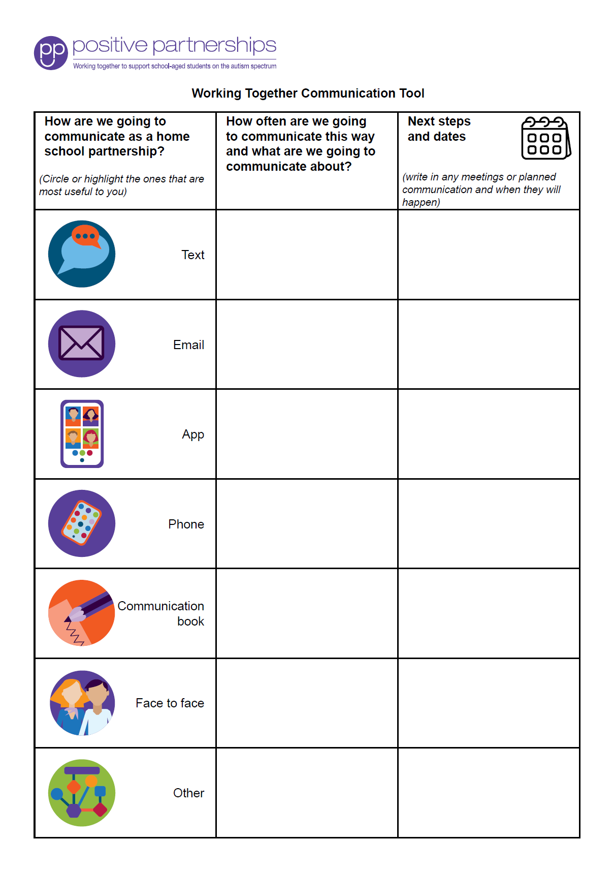
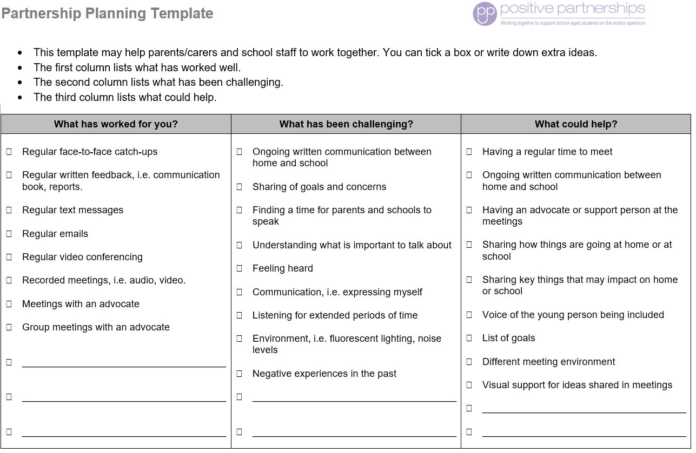
Partnership tools
Notes:
SUGGESTED TIME: 2 min · 3:05 - 3:07
PURPOSE
Demonstrate the Partnership tools and explain how they are used.
WHAT TO DO
1. Show the Partnership tools and explain how each is used.
2. Frame the tools as supports for consultation, not replacements for listening.
KEY MESSAGES
• Tools should support consultation rather than replace listening and student voice.

Slide 16
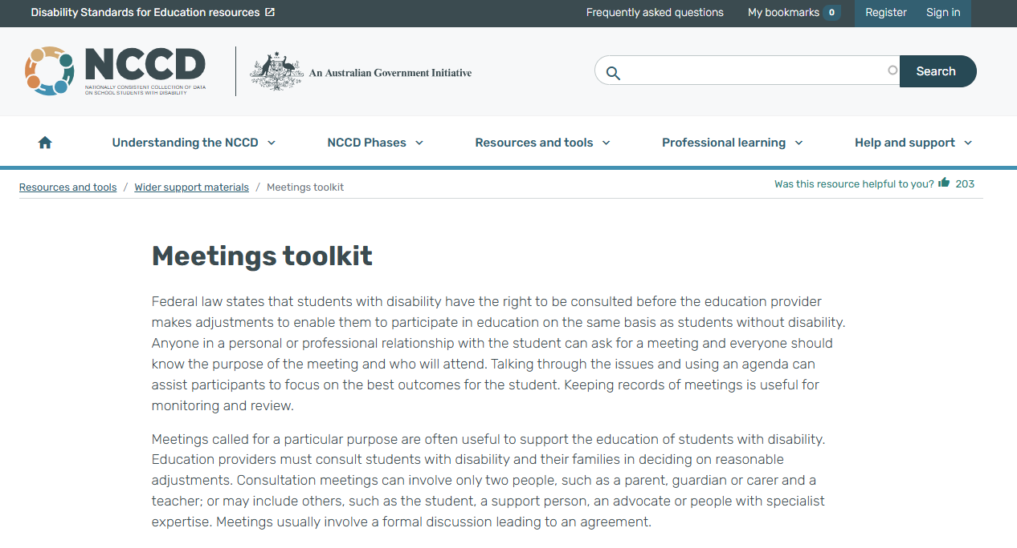
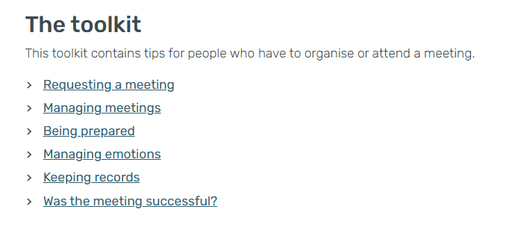
NCCD Meetings Tool Kit
Use the Tool Kit to make the meeting purpose, consultation process, possible adjustments, evidence and next steps clear. Follow the processes used in your school or system, and explain responsibilities and follow-up.
Notes:
SUGGESTED TIME: 2 min · 3:07 - 3:09
PURPOSE
Introduce the NCCD Meetings Tool Kit and direct participants to official NCCD information.
WHAT TO DO
1. Explain how the Tool Kit makes the meeting purpose, consultation process, possible adjustments, evidence and next steps clear.
2. Remind participants to follow the processes used in their school or system.
3. Emphasise explaining responsibilities and follow-up to families.
4. Note that consulted views, recorded and acted on, are part of the evidence for levels of adjustment.
5. Direct participants to official NCCD information.
KEY MESSAGES
• NCCD information must be current and official.

Slide 17
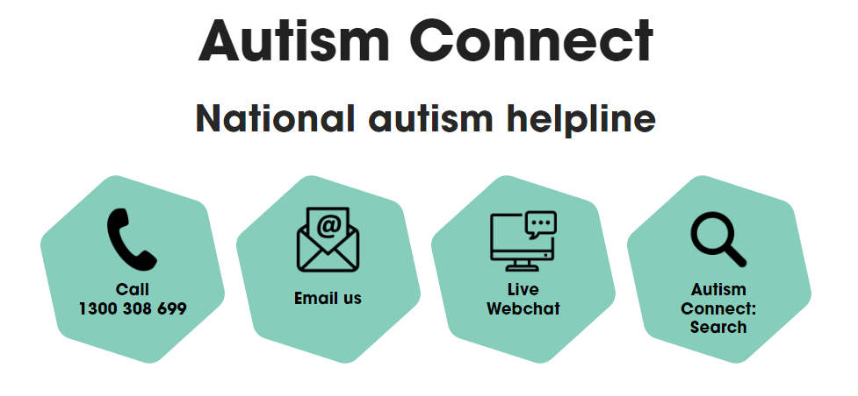


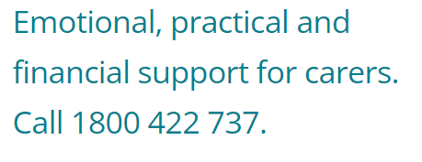

Other practical supports
Notes:
SUGGESTED TIME: 1 min · 3:09 - 3:10
PURPOSE
Introduce the support pathways included in the workshop.
WHAT TO DO
1. Briefly introduce the Positive Partnerships support options and other supports on the slide.
2. Point participants to Participant Guide p. 30 for resources.
KEY MESSAGES
• Introduce the Positive Partnerships support options included with the workshop.
KEEP IN MIND
• Check phone numbers and services are current before delivery.

Slide 18
Bridge to the next family conversation
Prepare for one purposeful conversation.
What needs to be understood?
What question will open the conversation?
How will the student take part, or have their views included?
What can be decided together?
How and when will the school follow up?
Keep these notes for your conversation plan in Session 6.
Notes:
SUGGESTED TIME: 5 min · 3:10 - 3:15 · Participant Guide p.25 - Bridge to the next family conversation
PURPOSE
Identify the question and shared purpose participants will take into the Session 6 conversation plan.
WHAT TO DO
1. Ask participants to return to the students they have in mind and their Session 4 design change (a lesson, an assessment task or a handover).
2. Invite them to work through the prompts on the slide privately. The opening question from the first two minutes (slide 9) can go straight in.
3. Keep the focus on preparation rather than scripting what the family or student should say.
4. Ask participants to carry one process change from the power reflection into the plan.
5. Ask how the student will take part in the conversation, or have their views included.
6. Preview the closing session on belonging, capacity, joy and practical next steps.
YOU MIGHT SAY
Keep these notes for your conversation plan in Session 6.
KEY MESSAGES
• Prepare for one purposeful conversation.
ACTIVITY: Private bridge reflection · on your own · 4 minutes, plus 1 minute to preview Session 6
Prompt: Prepare for one purposeful conversation.
1. What needs to be understood?
2. What question will open the conversation?
3. How will the student take part, or have their views included?
4. What can be decided together?
5. How and when will the school follow up?
Close: Keep these notes available for the conversation plan in Session 6.
THREAD
Connects to the Session 4 'My students' card ("Who I will involve") and the conversation plan in Session 6 (Participant Guide p. 28).

